Slide 1
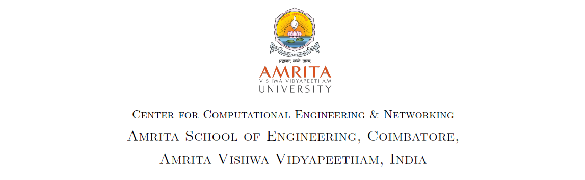
Transfer Learning Approach for Pediatric Pneumonia Diagnosis using Channel Attention Deep CNN Architectures
Arun Prakash J, Asswin C R, Dharshan Kumar K S, Avinash Dora
Guided by
Dr. Sowmya V, Dr. GopalaKrishnan E A
Notes:
Dharshan

Slide 2
Team Members
1
CB.EN.U4AIE19014 – Arun Prakash J
CB.EN.U4AIE19016 – C R Asswin
CB.EN.U4AIE19024 – Dharshan Kumar K S
CB.EN.U4AIE19028 – Avinash Dora
Pediatric Pneumonia Diagnosis using Channel Attention Deep CNN Architectures | CEN | Amrita School of Engineering
Notes:
Dharshan

Slide 3
OUTLINE
2
Introduction.
Problem Definition.
Open Questions / Gaps in Literature.
Objectives.
Dataset Description.
Methodology.
Results
Progress Timeline.
References.
Pediatric Pneumonia Diagnosis using Channel Attention Deep CNN Architectures | CEN | Amrita School of Engineering
Notes:
Dharshan

Slide 4
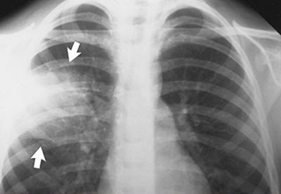
Introduction
3
Pneumonia
Lung disease caused by virus or bacteria which fills air sacs of lungs with fluid.
13% of all infant illness – 8,00,000 children including 1,53,000 new-born.
Traditional Methods
Pulse oximetry, CBC (complete blood count), Sputum test.
Cost & time inefficient.
Chest X-ray(CXR) images used as best alternative.
Figure 1: Pneumonia affecting lungs.
Pediatric Pneumonia Diagnosis using Channel Attention Deep CNN Architectures | CEN | Amrita School of Engineering
Notes:
Dharshan

Slide 5
Problem Definition
4
CXR images are examined by expert radiologists and doctors. It is a time-consuming process with human-prone errors
Low radiation levels in children leads to loss of information in these CXR images.
Proposed methodology is based on the feature fusion of ResNet50V2, ResNet101V2, ResNet152V2, DenseNet169, and Xception pretrained on the commonly available ImageNet weights along with channel attention for feature extraction
Our work proposes a light weight channel attention module attached to the end of pre-trained deep CNN models for pediatric pneumonia classification.
Pediatric Pneumonia Diagnosis using Channel Attention Deep CNN Architectures | CEN | Amrita School of Engineering
Notes:
Dharshan

Slide 6
Literature Review
5
A transfer learning method with deep residual network for pediatric pneumonia diagnosis
Gaobo et al. [1] addressed using residual connections to prevent spatial information loss in feature extraction.
Chexnet: Radiologist-level pneumonia detection on chest x-rays with deep learning
CheXNet [2] a deep CNN model built by Stanford's researchers trained on the ChestX-ray14 dataset, achieves a diagnosis capability better than the average radiologists.
Fusion of deep convolutional neural network with PCA and logistic regression for diagnosis of pediatric pneumonia on chest X-rays
Nahida et al. [3] reported the effects of using random undersampling, random oversampling, and SMOTE for data balancing.
Pediatric Pneumonia Diagnosis using Channel Attention Deep CNN Architectures | CEN | Amrita School of Engineering
Notes:
Dharshan

Slide 7
Literature Review
6
Towards Evaluating Performance of Domain Specific Transfer Learning for Pneumonia Detection from X-Ray Images
Mahajan et al. [4] examined deep CNN models trained on CheXnet weights, ImageNet weights, and random weights for pediatric pneumonia classification.
CGNet: A graph-knowledge embedded convolutional neural network for detection of pneumonia
Yu et al. [5] introduced graph-based feature reconstruction for pediatric pneumonia diagnosis termed CGNet.
Automated pneumonia diagnosis using a customized sequential convolutional neural network
Siddiqi et al. [6] introduced a purely depthwise separable network and suggested deep sequential CNN for the identification of pediatric pneumonia.
Pediatric Pneumonia Diagnosis using Channel Attention Deep CNN Architectures | CEN | Amrita School of Engineering
Notes:
Dharshan

Slide 8
Literature Review
7
A novel transfer learning based approach for pneumonia detection in chest X-ray images
Chouhan et al. [7] demonstrated improved performances in recent studies. A majority voting ensemble of AlexNet, DenseNet121, InceptionV3, GoogLeNet, and ResNet18 was utilized to make the final predictions.
A Deep Transfer Learning Framework for Pneumonia Detection from Chest X-ray Images
Islam et al. [9] illustrated using feature concatenations from SqueezeNet and InceptionV3 combined with ANNs to make predictions.
Pediatric Pneumonia Diagnosis using Channel Attention Deep CNN Architectures | CEN | Amrita School of Engineering
Notes:
Dharshan

Slide 9
Table : Comparing related works with our proposed work
Reference | Dataset | Pretrained model | Attention | Ensemble method
Gaobo Liang et al. [1] | Kermany et al. [13] | Custom CNN based on dilated convolutions | No | No
Nahida Habib et al. [3] | Kermany et al. [13] | CheXNet (DenseNet121) | No | No
Mahajan et al. [4] | Kermany et al. [13] | InceptionV3, DenseNet121 | No | No
Yu et al. [5] | Kermany et al. [13] | CGNet | No | No
Siddiqi et al. [6] | Kermany et al. [13] | Custom deep sequential CNN | No | No
Chouhan et al. [7] | Kermany et al. [13] | AlexNet, DenseNet121, ResNet18, IncpetionV3, GoogLeNet | No | Yes
Kora Venu Sagar [10] | Kermany et al. [13] | DenseNet201, Xception, InceptionResNet, ResNet152V2, MobileNetV2 | No | Yes
Mittal et al. [11] | Kermany et al. [13] | CapsNet | No | No
Islam et al. [9] | Kermany et al. [13] | SqueezeNet, InceptionV3 | No | No
Wu et al. [8] | Kermany et al. [13] | Adaptive median filter CNN | No | Yes
Current work | Kermany et al. [13] | ResNet50V2, ResNet101V2, ResNet152V2,Xception, DenseNet169 | Yes | Yes

Slide 10
Open Questions / Gaps in Literature
9
The absence of exploring ensemble approaches pertinent to pediatric pneumonia diagnosis was observed.
Most of the previous research failed to cover the aspect of feature visualization. Feature visualization is crucial to ensure that the learned features are meaningful for predictions.
Though most models result in accuracies of about 96%, the count of false positives is high due to class imbalance in the dataset.
Pediatric Pneumonia Diagnosis using Channel Attention Deep CNN Architectures | CEN | Amrita School of Engineering
Notes:
Dharshan

Slide 11
Open Questions / Gaps in Literature
10
5. Several works propose the use of CheXnet weights for custom CNN training, which is challenging.
6. Data sampling methods like ROS and SMOTE lead to longer training times. While ROS contributes no new data, the data generated using SMOTE is not guaranteed to capture the intrinsic patterns in pneumonia-based chest-X rays.
7. The absence of exploring attention mechanisms with very little computational overhead pertinent to pediatric pneumonia diagnosis was observed.
Pediatric Pneumonia Diagnosis using Channel Attention Deep CNN Architectures | CEN | Amrita School of Engineering
Notes:
Dharshan

Slide 12
Objectives
11
To develop a modified deep CNN architectures with channel attention inspired by Squeeze and Excitation Networks.
To implement a feature concatenation-based stacking ensemble.
To show Class Activation Maps (CAM) and t-distributed stochastic neighbor embedding (t-SNE) based feature visualization for interpretability of the features.
To implement Kernel PCA for redundant feature reduction.
To compare with existing deep CNN architectures and other recent works.
To perform analysis on similar lung disease datasets to prove its generalizability.
Pediatric Pneumonia Diagnosis using Channel Attention Deep CNN Architectures | CEN | Amrita School of Engineering
Notes:
CR

Slide 13
Dataset Description
12
Original Dataset - [Guangzhou Women and Children's Medical Center]
Category | Train | Test
Normal | 1349 | 234
Pneumonia | 3883 | 390
Total | 5232 | 624
Methods​ | Corresponding Parameters​
Rescale​ | 255​
Shear​ | 0.2​
Zoom​ | 0.2​
Horizontal Flip​ | True​
Vertical Flip​ | True​
Augmented Dataset
Category | Train | Test | Validation
Normal | 3,884 | 234 | 970
Pneumonia | 3,883 | 390 | 970
Total | 7767 | 624 | 1940
Table 1: Augmentations used in our study and their corresponding values
Pediatric Pneumonia Diagnosis using Channel Attention Deep CNN Architectures | CEN | Amrita School of Engineering
Notes:
Dharshan

Slide 14
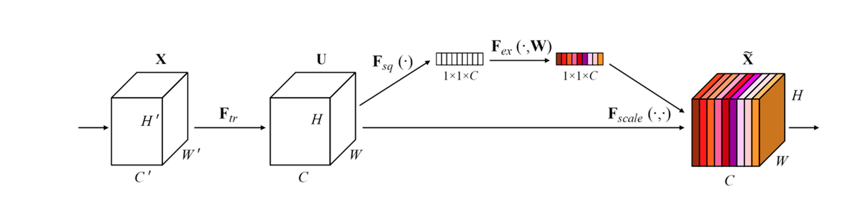
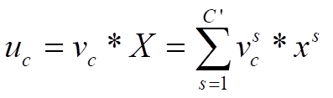
Methodology
13
Squeeze and Excitation block (SE):
Suppress less useful features
Emphasize informative features
Pediatric Pneumonia Diagnosis using Channel Attention Deep CNN Architectures | CEN | Amrita School of Engineering
Notes:
Dharshan

Slide 15
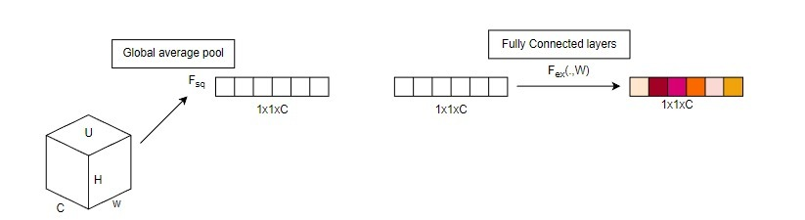
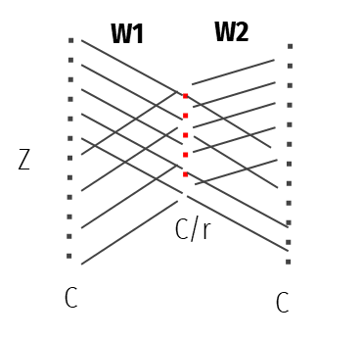
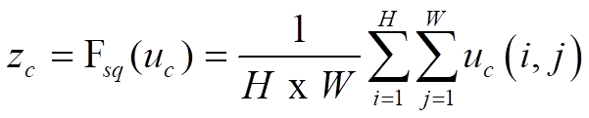
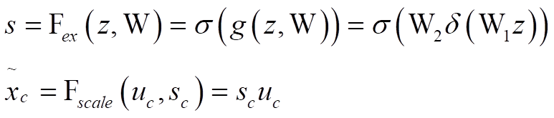
Methodology
14
Squeeze
Excitation
Aggregating features maps across their spatial dimension (H x W).
Collection of per-channel modulation weights.
Pediatric Pneumonia Diagnosis using Channel Attention Deep CNN Architectures | CEN | Amrita School of Engineering
Notes:
Dharshan

Slide 16
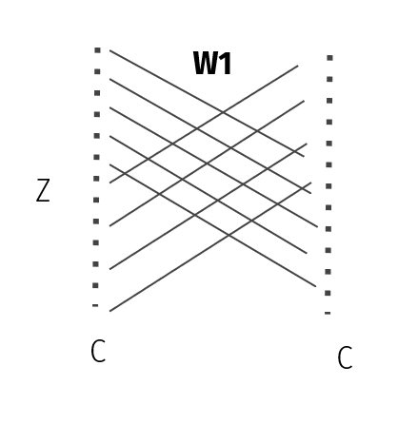
Methodology - Novelty
15
Excitation
Excitation Block
Modified Excitation Block
Pediatric Pneumonia Diagnosis using Channel Attention Deep CNN Architectures | CEN | Amrita School of Engineering
Notes:
Dharshan

Slide 17
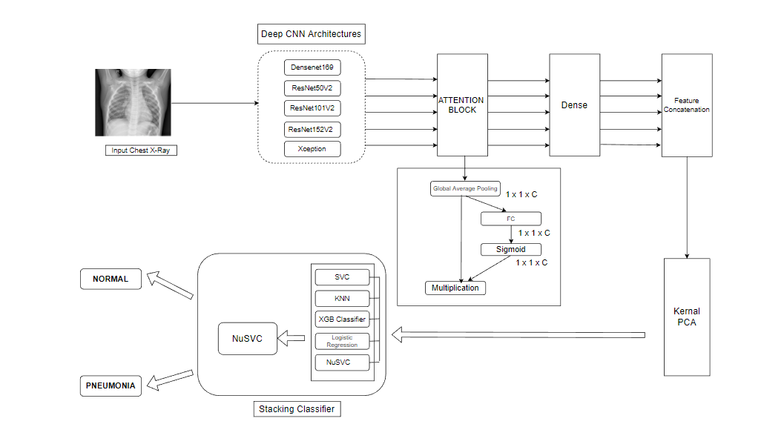
Methodology - Pipeline
16
Pediatric Pneumonia Diagnosis using Channel Attention Deep CNN Architectures | CEN | Amrita School of Engineering
Notes:
Dharshan

Slide 18
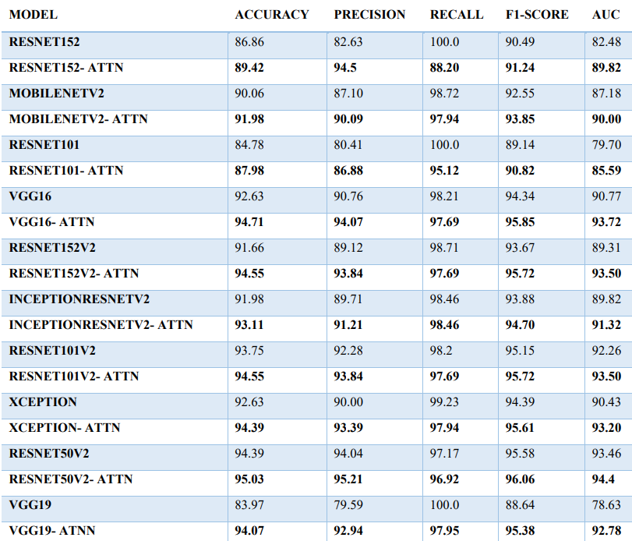
Experiments
17
Fine-tuning from the second half of all the layers in the model
Batch size – 32
Epoch – 30
Optimizer – Adam
Learning rate – 0.00001
Pediatric Pneumonia Diagnosis using Channel Attention Deep CNN Architectures | CEN | Amrita School of Engineering
Notes:
Dharshan

Slide 19
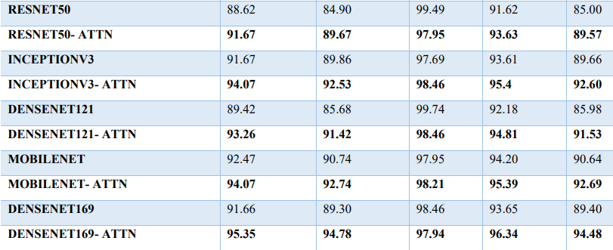
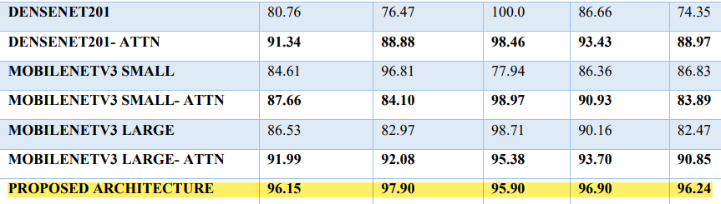
Experiments
18
Fine-tuning from the second half of all the layers in the model
Batch size – 32
Epoch – 30
Optimizer – Adam
Learning rate – 0.00001
Channel attention increases accuracy from 1% to 4%
Pediatric Pneumonia Diagnosis using Channel Attention Deep CNN Architectures | CEN | Amrita School of Engineering
Notes:
Dharshan

Slide 20
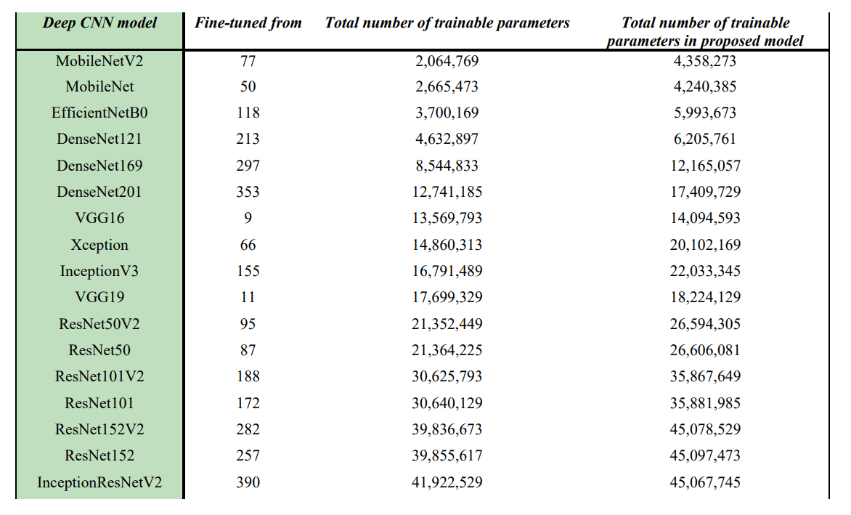
Parameters in models
19
Pediatric Pneumonia Diagnosis using Channel Attention Deep CNN Architectures | CEN | Amrita School of Engineering
Notes:
Dharshan

Slide 21
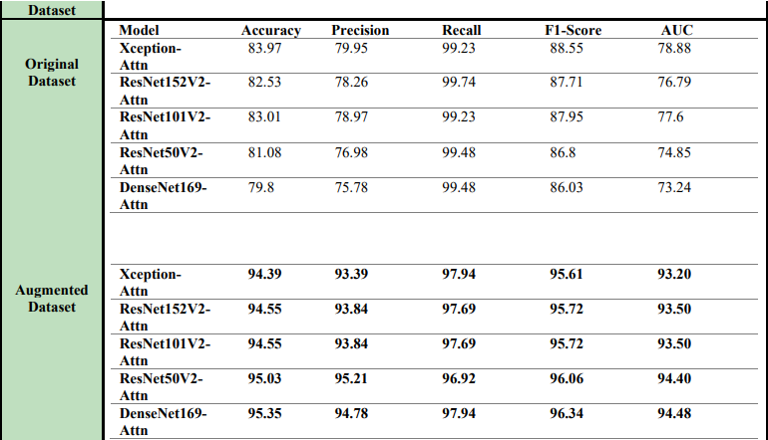
Experiments – Augmented Dataset
21
Pediatric Pneumonia Diagnosis using Channel Attention Deep CNN Architectures | CEN | Amrita School of Engineering
Notes:
Dharshan

Slide 22
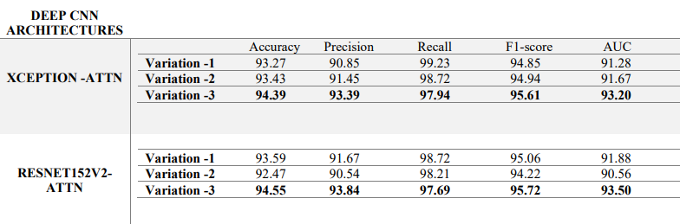
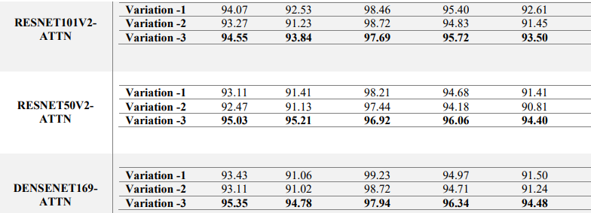
Experiments – Variations in SE block
22
Modified Excitation Block
Reduces no. of parameters
Pediatric Pneumonia Diagnosis using Channel Attention Deep CNN Architectures | CEN | Amrita School of Engineering
Notes:
Dharshan

Slide 23
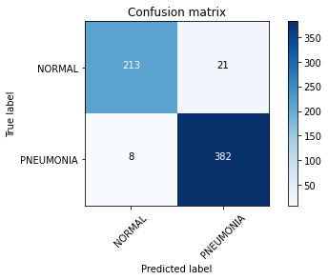
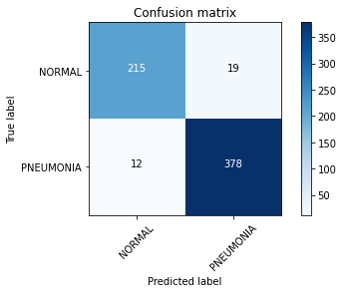
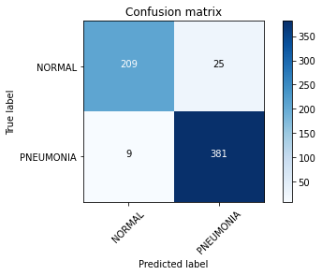

Result – Confusion Matrix
23
DenseNet169-Attn
ResNet50V2-Attn
ResNet101V2-Attn
ResNet152V2-Attn
Xception-Attn
Pediatric Pneumonia Diagnosis using Channel Attention Deep CNN Architectures | CEN | Amrita School of Engineering
Notes:
Dharshan

Slide 24
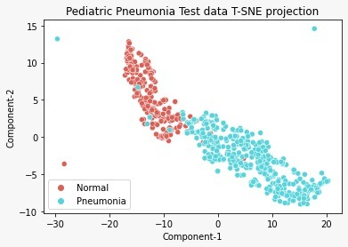
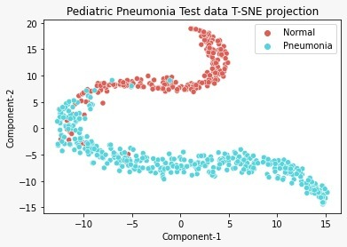
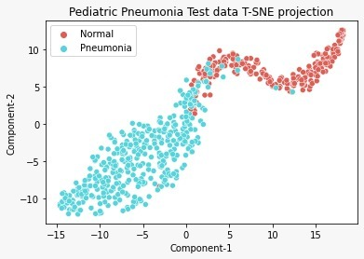
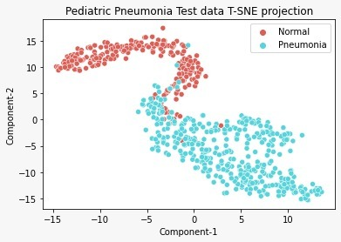
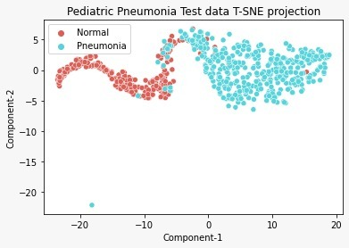
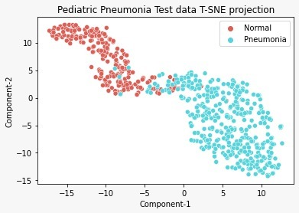
Result – t-SNE Plots
24
DenseNet169-Attn
Xception-Attn
ResNet50V2-Attn
Feature concatenation of ResNet50V2-Attn, ResNet101V2-Attn, ResNet152V2-Attn, DenseNet169-Attn, and Xception-Attn
ResNet101V2-Attn
ResNet152V2-Attn
Pediatric Pneumonia Diagnosis using Channel Attention Deep CNN Architectures | CEN | Amrita School of Engineering
Notes:
Dharshan

Slide 25
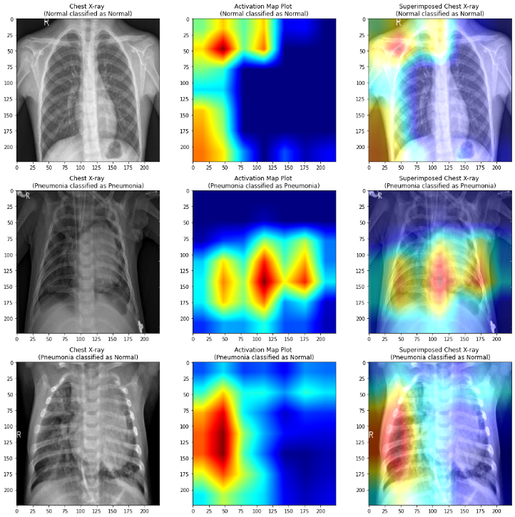
Result – Activation Map
25
Class activation maps of classified Chest X-rays from Xception-Attn
Pediatric Pneumonia Diagnosis using Channel Attention Deep CNN Architectures | CEN | Amrita School of Engineering
Notes:
Dharshan

Slide 26
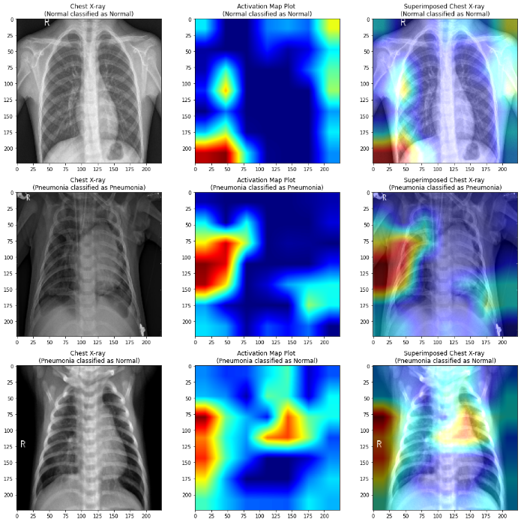
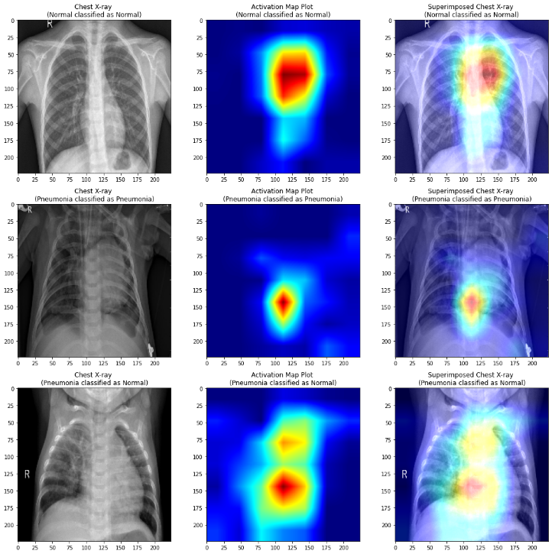
Result – Activation Map
26
Class activation maps of classified Chest X-rays from ResNet50V2-Attn
Class activation maps of classified Chest X-rays from ResNet101V2-Attn
Pediatric Pneumonia Diagnosis using Channel Attention Deep CNN Architectures | CEN | Amrita School of Engineering
Notes:
Dharshan

Slide 27
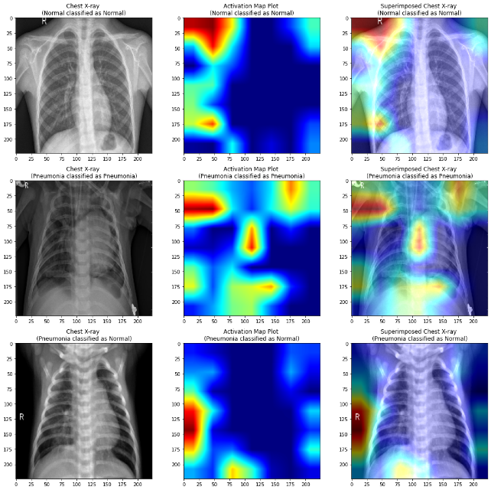
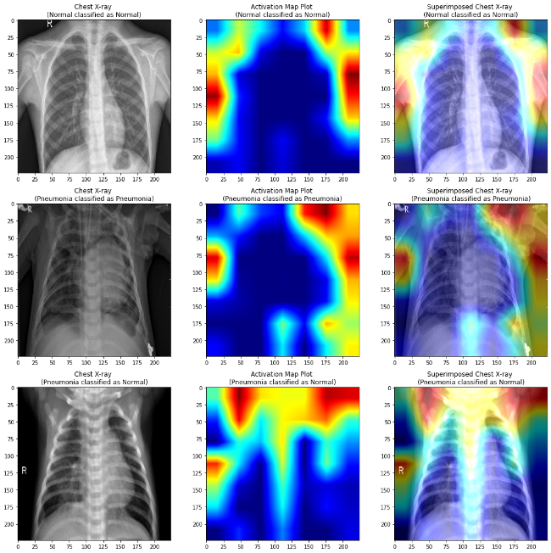
Result – Activation Map
27
Class activation maps of classified Chest X-rays from ResNet152V2-Attn
Class activation maps of classified Chest X-rays from DenseNet169-Attn
Pediatric Pneumonia Diagnosis using Channel Attention Deep CNN Architectures | CEN | Amrita School of Engineering
Notes:
CR

Slide 28
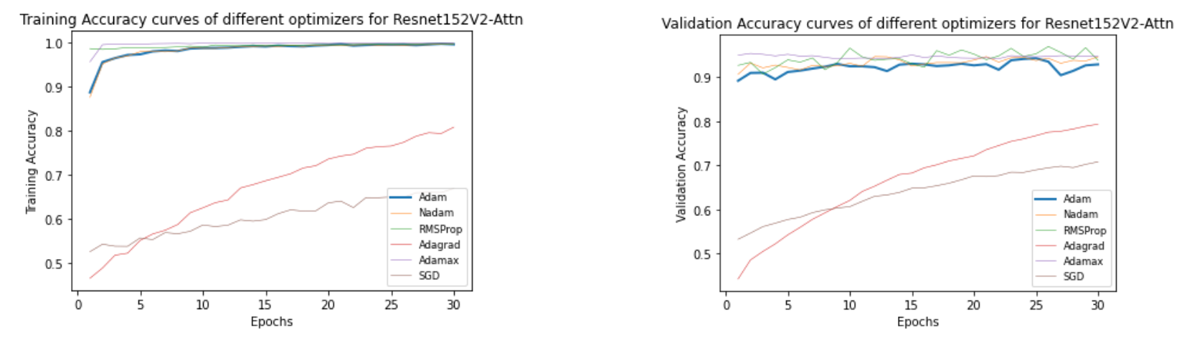
Experiments – Hyper parameter tuning
28
Model performance on the validation set using different optimizers
Pediatric Pneumonia Diagnosis using Channel Attention Deep CNN Architectures | CEN | Amrita School of Engineering
Notes:
CR

Slide 29
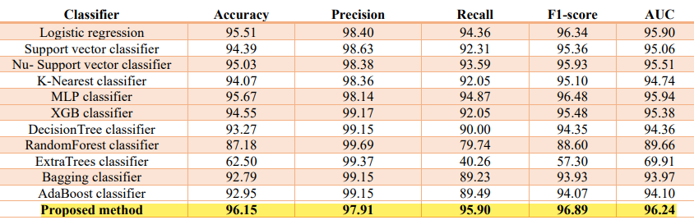
Experiments – ML algorithms
29
Performance comparison of different machine learning classifiers with the stacking classifier with values rounded off to the nearest two decimal positions
Pediatric Pneumonia Diagnosis using Channel Attention Deep CNN Architectures | CEN | Amrita School of Engineering
Notes:
Arun

Slide 30
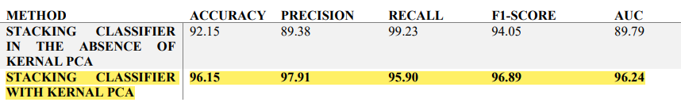
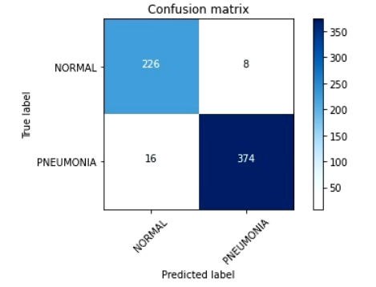
Experiments – Kernel PCA
30
Comparison of stacked ensemble learning with and without kernel PCA
Pediatric Pneumonia Diagnosis using Channel Attention Deep CNN Architectures | CEN | Amrita School of Engineering
Notes:
Arun

Slide 31
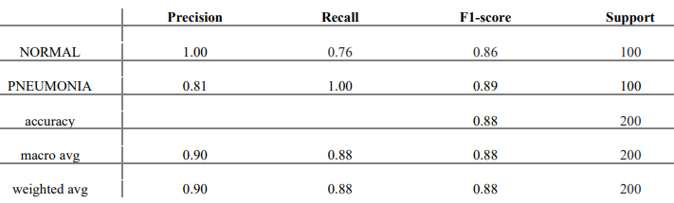
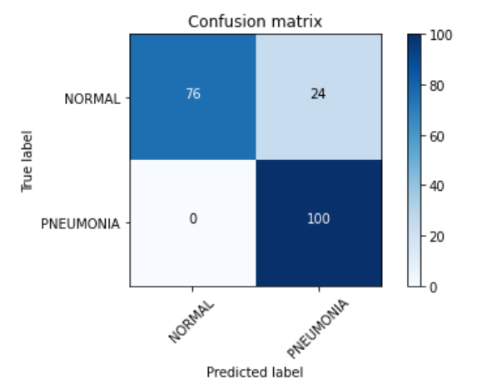
Performance on unseen dataset
31
Pneumonia Dataset – Adult & Child
Pediatric Pneumonia Diagnosis using Channel Attention Deep CNN Architectures | CEN | Amrita School of Engineering
Notes:
Dharshan

Slide 32
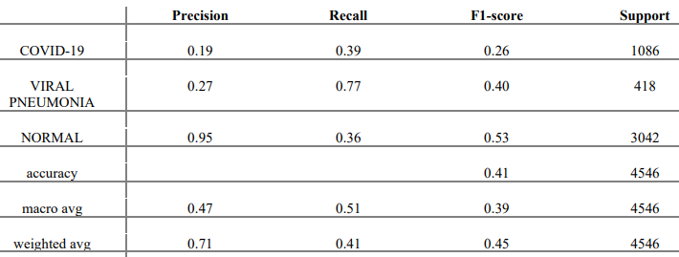
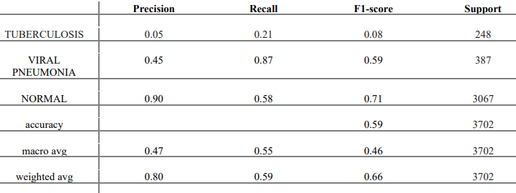
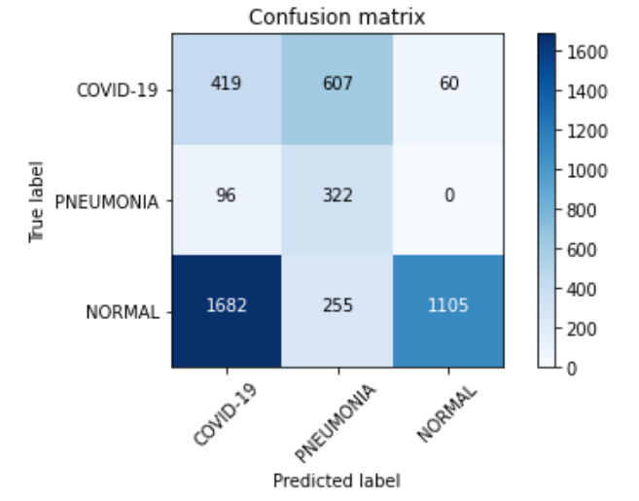
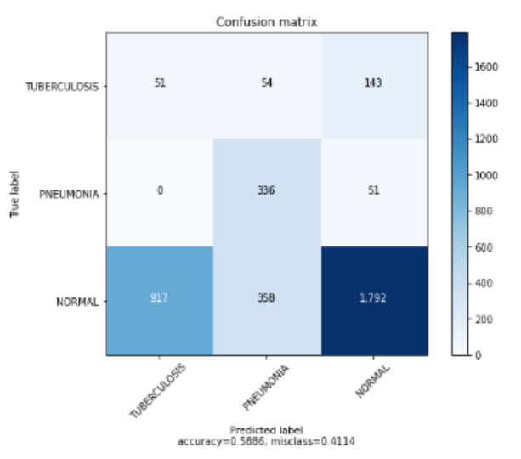
Robustness of trained models
32
COVID Dataset
Tuberculosis Dataset
Pediatric Pneumonia Diagnosis using Channel Attention Deep CNN Architectures | CEN | Amrita School of Engineering
Notes:
Dharshan

Slide 33
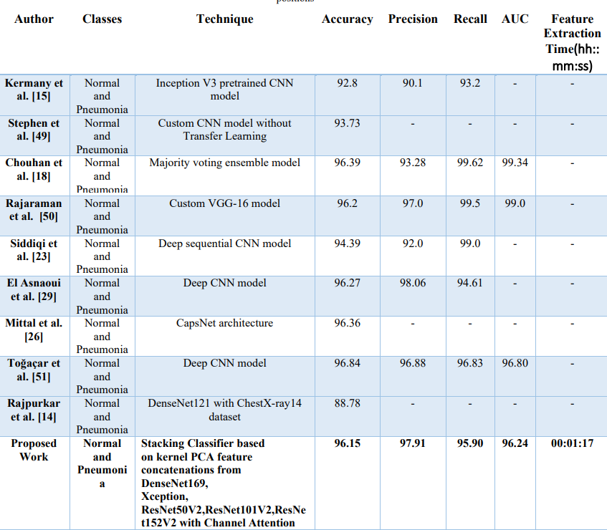
Comparison with Recent Works
33
Pediatric Pneumonia Diagnosis using Channel Attention Deep CNN Architectures | CEN | Amrita School of Engineering
Notes:
Dora

Slide 34
Conclusion
34
Augmented Dataset to cope up with data imbalance.
Channel attention module inspired by Squeeze and Excitation block for feature extraction.
Visualized using t-SNE feature representations and class activation maps.
Kernel PCA inputs the best-performing models' features concatenated for dimensionality reduction.
Stacking classifier for the final – Normal, Pneumonia classification.
Transfer learning on pre-trained models to compensate for the availability of a limited dataset.
Tested on other unseen lung disease datasets to validate the performance across unseen data for inference.
Accuracy of 96.15%, F1-score of 96.89%, and AUC value of 96.24%.
Pediatric Pneumonia Diagnosis using Channel Attention Deep CNN Architectures | CEN | Amrita School of Engineering
Notes:
Dora

Slide 35
Limitations
35
The limitation of this study is the use of an augmented dataset with new samples obtained by various geometric transformations.
Another disadvantage is the reliance on the right combination of base estimators of Stacking classifier for accurate classification.
Other limitations include the inability to subclassify into different stages of pediatric pneumonia, such as early, latent and severe.
Pediatric Pneumonia Diagnosis using Channel Attention Deep CNN Architectures | CEN | Amrita School of Engineering
Notes:
Dora

Slide 36
Future Works
36
We would like to explore GANs for dataset augmentation.
t-SNE plots conclude the need for better attention modules incorporating spatial attention to capture many more intrinsic patterns. CBAM modules can be tried to improve accuracy.
Explore using semi-supervised learning as it is a promising approach for feature learning on a limited dataset.
Pediatric Pneumonia Diagnosis using Channel Attention Deep CNN Architectures | CEN | Amrita School of Engineering
Notes:
Dora

Slide 37
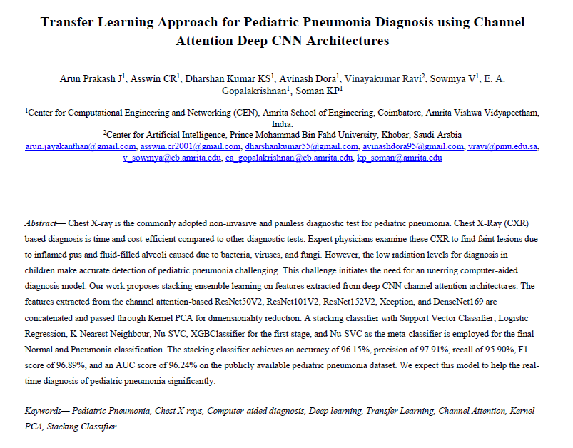
Journal Submission
37
Journal draft under review at Engineering applications of Artificial Intelligence.
Pediatric Pneumonia Diagnosis using Channel Attention Deep CNN Architectures | CEN | Amrita School of Engineering
Notes:
Dora

Slide 38
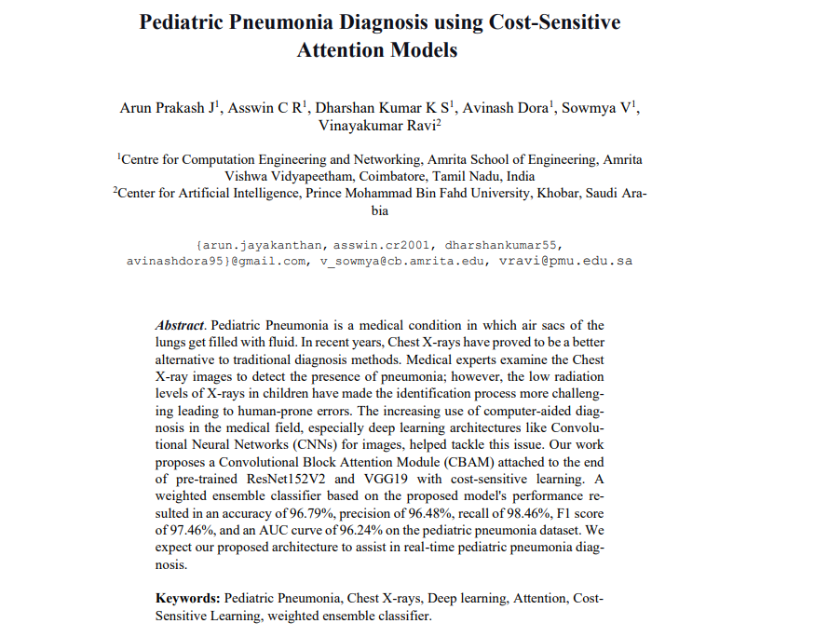
Conference Submission
38
Conference paper accepted at 3rd International Conference Computer Vision, High Performance Computing, Smart Devices and Networks (CHSN 2022).
Pediatric Pneumonia Diagnosis using Channel Attention Deep CNN Architectures | CEN | Amrita School of Engineering
Notes:
Dora

Slide 39
Individual Contributions
39
Experimenting with Attention blocks
3 Variations of SE blocks
Augmentation of Dataset
Dimensionality Reduction
Stacking classifier
Activation Map
Training Models & Hyper-parameter tuning
- Arun & Asswin
- Arun & Asswin
- Avinash
- Dharshan Kumar
- Dharshan & Avinash
- All 4 members split equally
Pediatric Pneumonia Diagnosis using Channel Attention Deep CNN Architectures | CEN | Amrita School of Engineering
Notes:
Dora

Slide 40
References
40
[1] Liang, Gaobo, and Lixin Zheng. "A transfer learning method with deep residual network for pediatric pneumonia diagnosis." Computer methods and programs in biomedicine 187 (2020): 104964.
[2] Rajpurkar, Pranav, et al. "Chexnet: Radiologist-level pneumonia detection on chest x-rays with deep learning." arXiv preprint arXiv:1711.05225 (2017).
[3] Habib, Nahida, Md Mahmodul Hasan, and Mohammad Motiur Rahman. "Fusion of deep convolutional neural network with PCA and logistic regression for diagnosis of pediatric pneumonia on chest X-rays." Network Biol 76 (2020).
[4] Mahajan, Sarang, et al. "Towards Evaluating Performance of Domain Specific Transfer Learning for Pneumonia Detection from X-Ray Images." 2019 IEEE 5th International Conference for Convergence in Technology (I2CT). IEEE, 2019.
[5] Yu, Xiang, Shui-Hua Wang, and Yu-Dong Zhang. "CGNet: A graph-knowledge embedded convolutional neural network for detection of pneumonia." Information Processing & Management 58.1 (2021): 102411.
[6] Siddiqi, Raheel. "Automated pneumonia diagnosis using a customized sequential convolutional neural network." Proceedings of the 2019 3rd international conference on deep learning technologies. 2019.
Pediatric Pneumonia Diagnosis using Channel Attention Deep CNN Architectures | CEN | Amrita School of Engineering

Slide 41
References
41
[7] Chouhan, Vikash, et al. "A novel transfer learning based approach for pneumonia detection in chest X-ray images." Applied Sciences 10.2 (2020): 559.
[8] Wu, Huaiguang, et al. "Predict pneumonia with chest X-ray images based on convolutional deep neural learning networks." Journal of Intelligent & Fuzzy Systems 39.3 (2020): 2893-2907.
[9] Islam, Kh Tohidul, et al. "A Deep Transfer Learning Framework for Pneumonia Detection from Chest X-ray Images." VISIGRAPP (5: VISAPP). 2020.
[10] Venu, Sagar Kora. "An ensemble-based approach by fine-tuning the deep transfer learning models to classify pneumonia from chest X-ray images." arXiv preprint arXiv:2011.05543 (2020).
[11] Mittal, Ansh, et al. "Detecting pneumonia using convolutions and dynamic capsule routing for chest X-ray images." Sensors 20.4 (2020): 1068.
[12] Hu, J., Shen, L., Sun, G.: Squeeze-and-excitation networks. arXiv preprint arXiv:1709.01507 (2017).
[13] Kermany, Daniel S., et al. "Identifying medical diagnoses and treatable diseases by image-based deep learning." Cell 172.5 (2018): 1122- 1131.
Pediatric Pneumonia Diagnosis using Channel Attention Deep CNN Architectures | CEN | Amrita School of Engineering

Slide 42
Thank You
Pediatric Pneumonia Diagnosis using Channel Attention Deep CNN Architectures | CEN | Amrita School of Engineering

